Slide 1
SUPPLEMENTAL BENEFITS
Beth Wiley

Slide 2
AGENDA
Impact Solutions
Healthy U
UT Pharmacies
Life Insurance
Tuition Waiver
Retirement Plans
Medical Insurance Related Benefits
Credit Union
Early Learning Center
UT Discounts
Other Miscellaneous Benefits

Slide 3

IMPACT SOLUTIONS
The IMPACT Employee Assistance (EAP) & Work/Life Program is a program available to you and your family offering access to confidential professional support 24 hours a day, 365 days a year. All IMPACT counselors are qualified masters/ doctoral level professionals.
Employee Assistance Program
Free, Confidential, 24/7/365 phone consultations with licensed mental health professional
5 complimentary face-to-face counseling sessions per person
Legal Assistance
Identity Theft Prevention and Recovery
Financial Planning and Counseling Services
Telephonic Coaching Services
Work/Life Web Services – articles, webinars, referrals, online tools
Notes:
Impact Solutions – 2 Parts: Employee Assistance Program and Work/Life Program
Employee Assistance Program provides free, confidential consultations with licensed mental health professionals. Also, 5 complimentary face-to-face counseling sessions per person
Work Life Program – Legal Assistance, Identity Theft Assistance, Financial Planning Assistance and other telephonic services (caregiver support, nutrition counseling, etc.).
Web Services include articles, webinars, financial calculators, self assessment surveys, referral locators and a lot more. One of my favorite things on the website is the legal forms section – there are over 100 common legal forms that you can download and personalize. Wills, Livings Trusts and Real Estate Forms are just a few of the forms available!

Slide 4
TESS – 24/7 Mental Health Chat Bot
Start chatting by texting “Hi” to 1-415-360-0023. Start Code UT
Like a coach, Tess works to understand your need by asking “How are you?”
Tess delivers coping strategies based on the emotions you express.
Completely confidential, you can stop a conversation at any time.
Proven to reduce depression by 28% and anxiety by 18%.
Notes:
Tess is a new 24/7 mental health chat bot that coaches people through tough times to build resilience, by having text message conversations - similar to texting with a friend or coach

Slide 5

HEALTHY U
Healthy U is the University of Toledo’s employee wellness program. It is a free, voluntary program that is available to all benefit-eligible employees. Opt-in during Open Enrollment
Lifestyle change programs
Blood pressure
Nutrition
Physical activity
Stress management
Health Coaching
Health Risk Assessment
Webinars
Diabetes Prevention Program
http://www.utoledo.edu/offices/rocketwellness/healthyu/
Notes:
Some of you may have heard of the University’s Healthy U program already but for those that have not, Healthy U is our wellness program. It is free and available to all employees. The Healthy U staff puts on a lot of programs throughout the year geared toward physical, emotional and financial wellness. Incentives are available by participating and completing programs throughout the year.

Slide 6

UTOLEDO PHARMACIES
3 Pharmacies on Campus
Health Science Campus
Main Campus
UT Access in the Comprehensive Care Center
Save Money by Using UToledo Pharmacy!
Pay only cost of medication (even if less than copay)
15% Discount when prescribed by UTMC physician and filled at UT pharmacy
Mail order prescriptions available.
Phone App - RXLocal
Notes:
May know that we have 3 pharmacies on campus that are available for you to use. By using a UT Pharmacy, you can save money on copays because UT Pharmacies can get medications cheaper than retail pharmacies can. And you pay either the cost of the medication or the copay, whichever is less expensive. Many of our benefit plans are also designed so that the prescription copay is less at UT Pharmacies than other pharmacies.

Slide 7
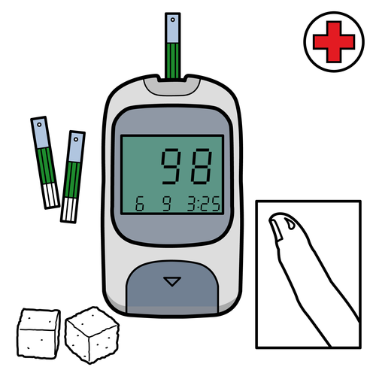
UTOLEDO PHARMACIES TELCARE PROGRAM
Free Meters and Test Strips
Currently Taking Insulin Product OR
Currently Taking 2 Oral Diabetes Medications
Contact Bree Meinzer at
419-383-1591
Notes:
UT offers a diabetes management program that offers free meters and test strips to employees who meet one of the requirements shown. More information about this program can be found at the UT Outpatient Pharmacy website or by calling Bree Meinzer, one of our pharmacists, at the number listed here. This program is also available to adult family members covered under a UT medical plan.

Slide 8
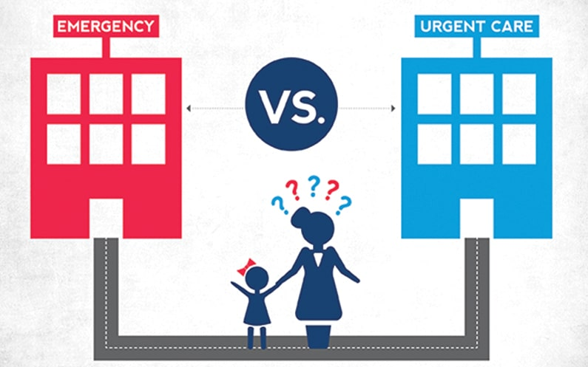
ON DEMAND VIRTUAL CARE
Available daily from 8am – 10pm
Simple, secure care with a healthcare provider from the comfort of your home, office, or residence hall.
Easy access from your mobile device, tablet, or computer
http://utmc.utoledo.edu/telemedicine/
Notes:
Eligibility:
UToledo Student Health Insurance Plan co-pay, deductible or co-insurance will apply.
UToledo insurance regardless of plan Paramount, Anthem and FrontPath co-pay, deductible or co-insurance will apply.
Self-pay or no insurance coverage only $59 per visit.
All other insurance will be billed in line with plan coverage; co-pay, co-insurance and deductible will apply.
Conditions we treat:
Acute non-life threatening conditions, Pink eye, Headaches, Infections, Ear ache, Rash, Respiratory problems, Sore throat, Sinusitis, Vomiting/diarrhea, Bronchitis, Sprains and strains, Anxiety/ depression, STD, Urinary tract infections

Slide 9

LIFE INSURANCE
Portability and Conversion
Seatbelt/Airbag Additional Payment
Education Benefit
Emergency Travel Assistance (Assist America)
Additional Voluntary Employee, Spousal, and Child Dependent Life available to elect at any time.
Notes:
You all know that the University provides a base amount of life insurance so I just want to share with you some features of you may not be aware of.
If you leave our employment, you have the option to convert your life insurance to a personal term life policy or convert it to a whole life policy with no medical exam required. Our new vendor, Unum will have a dedicated UT phone line to assist former employees with this process.
Our new policy offers additional benefits to your beneficiaries if you were to die in a car crash and have working airbags ($5000) and were wearing a seatbelt ($25,000). There is also an educational assistance benefit available if you leave behind college-age children.
Unum contracts with Assist America to provide emergency travel assistance to UT employees. These services include medical consultation, lost prescription assistance, emergency medical evacuation, legal and interpreter referrals, lost luggage assistance and other services. This benefit is also available through our current carrier, SunLife, so you don’t have to wait until January to take advantage of it, if needed.
Additional Life coverage for yourself, spouse, or child dependents can also be elected.

Slide 10

TUITION WAIVER
Employees
Available to Full Time and Part Time (at least .5 FTE) Staff
Up to 8 undergraduate or graduate credit hours per semester
Reciprocal agreement with BGSU for courses not offered at UT
Excludes JD and MD.
Spouses/Dependents
After 1 year of service
Undergraduate classes
Educational Development Incentive
After 1 year of service
Earn degree (Associate’s, Bachelor’s, Master’s) from accredited college or university
$1,000 base pay increase for classified employees
If you wish to apply, please submit a request through your Manager or Department Leader.

Slide 11
RETIREMENT PLANS
403(b)
Contribute up to $19,500 pre-tax
Invest in mutual funds
Select from list of vendors
Roth option available
Retirement@work portal for easy access and changes.
457(b)
Contribute up to $19,500 pre-tax
No early withdraw penalties
Variety of investment options
Roth option available
Administered by Ohio Deferred Compensation
* Can potentially contribute maximum to both plans*
Investment advisors are always available by appointment to meet with you about your retirement investments and goals!
Notes:
Optional retirement plans. Tax benefits and save for retirement. If in ARP or 403b plans, can always call and meet with your chosen vendor to review your investments and options.

Slide 12

EARLY LEARNING CENTER
Accredited child care center
Child Care and Preschool
Infants through 10 years old
M-F 6:30 am-6:00 pm
Located just south of Health Science Campus on Birchwood Ave.
Payroll deduction
5 star rating
On site nurse
Nutritional hot meals
EarlyLearnCTR@utoledo.edu
(419) 530-6710
Notes:
UT has an accredited child care center that is available for employee and public use. They provide child care and preschool services for infants through age 10.

Slide 13
BANKING
Huntington Bank – Campus Branches
Interest Bearing Checking Accounts with no monthly maintenance fee
Credit Card Bonuses
ATM Withdrawal Rebate
Notes:
Utoledo has partnership with Huntington bank to offer interest earning checking accounts to Utoledo employees.
Also offer bonuses on their credit card products and will waiver fee for non-Huntington ATM withdrawals
Open at any campus branch

Slide 14

UToledo Discounts
UTMC Gift Shop
UT Bookstore
Renee’s Survivor Shop
Rocky’s Locker
Student Rec Center
Rocket Wireless
Athletics
Notes:
Employee Discounts available at UTMC gift shop, UT bookstore, Renee’s Survivor Shop and Rocky’s locker
Student Rec Center – membership available at discounted rate and can be paid through payroll deduction
Rocket Wireless – Special pricing available for Verizon and Sprint plans through Rocket Wireless – Student Union
Athletic Tickets – 2 season or individual tickets at ½ price, free parking

Slide 15
OTHER DISCOUNTS
Toledo Museum of Art
Free Parking in Lot 3
Mud Hens and Walleye Tickets
Special Offers with code “UTSTAFF”
Discounts
Area Hotels
Yark Auto
Computers and Software
Great Wolf Lodge
Shopping Discounts through Corporate Shopping and Vizient
UToledo.edu
Search for Employee Resources
Notes:
I encourage all of you to go to utoledo.edu and search for employee resources. Here you will find a bunch of discounts, savings and services that are offered to you as a UT employee. There are many local, regional and national discounts available to you including area hotels, event tickets, free parking, and even car shopping. You can also find the link to purchase discounted computer equipment and software packages.

Slide 16
Thank You!
Questions? Please reach out to Benefits@utoledo.edu.

